Slide 1
ADDUCTOR CANAL
BY
DR OJEWALE A.O

Slide 2
Outline
Intro’
Boundaries
Contents
Applied Anatomy

Slide 3
ADDUCTOR (SUBSARTORIAL) CANAL (HUNTER’S CANAL)
It is an aponeurotic tunnel located on the medial side of the middle one-third of the thigh (deep to the middle one-third of the sartorius).
It extends from the apex of the femoral triangle, above, to the tendinous opening in the adductor magnus, below. It provides passage to the femoral vessels from femoral triangle to the popliteal fossa.

Slide 4
Cont’d
It measures about 15 cm in its proximodistal extent.
It is triangular in cross-section, its fascial wall being supported by muscles.
It contains two vessels and two nerves; these include femoral artery, femoral vein, saphenous nerve, and nerve to vastus medialis.

Slide 5
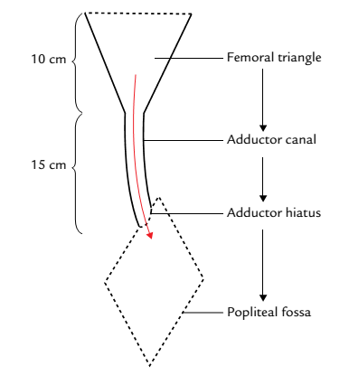
Femoral triangle and adductor canal

Slide 6
Boundaries
The adductor canal is bounded:
Anterolaterally by vastus medialis.
Posterior (floor) by adductor longus above and adductor magnus below.
Anteromedial wall (roof): It is formed by a strong fibrous membrane stretching across the anterolateral and posterior boundaries. The roof is overlapped by the sartorius muscle.

Slide 7
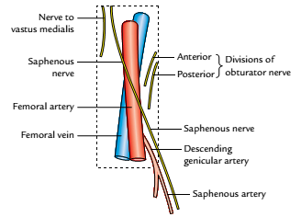
Contents of the adductor canal
Femoral artery.
Femoral vein.
Saphenous nerve.
Nerve to vastus medialis.
Anterior and posterior
divisions of the obturator nerve
Descending genicular artery,
a branch of the femoral artery.
Contents of the adductor canal

Slide 8
Regarding the contents of adductor canal, note that
The femoral artery enters the canal at the apex of the femoral triangle, traverses the whole length of the adductor canal, and leaves it by passing through the tendinous opening (adductor hiatus). in the adductor magnus Within the canal, it gives off muscular branches and a descending genicular branch. The descending genicular artery arises before the femoral artery leaves the canal.

Slide 9
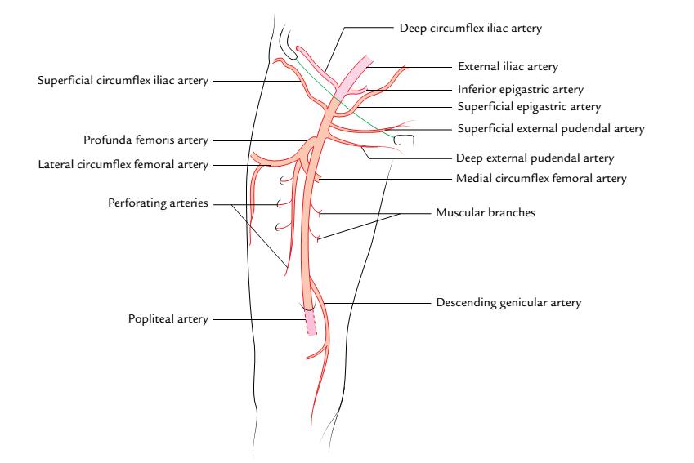
Branches of the femoral artery

Slide 10
The femoral vein lies posterior to the femoral artery in the upper part and posterolateral to the artery in the lower part.
The saphenous nerve (longest cutaneous nerve of the body) crosses the adductor canal initially lateral, then anterior and finally medial to femoral artery. It leaves the canal proximal to the adductor opening by piercing the fibrous membrane. It gives off infrapatellar branch as it exits the canal which pierces the sartorius, and joins the patellar plexus and supplies the prepatellar skin.
Cont’d

Slide 11
Cont’d
The saphenous nerve is the longest and largest branch of femoral nerve.
It arises from the femoral nerve in the femoral triangle; here, it descends lateral to femoral artery.
It leaves the femoral triangle at its apex, to enter the adductor canal.
It pierces the fascial medial wall of the canal, proximal to the adductor opening, to emerge medial to the knee (between sartorius and gracilis), where it becomes subcutaneous.
It continues to descend on the medial aspect of the knee and leg, where it is accompanied by the great saphenous vein

Slide 12
Cont’d
It passes anterior to the ankle, to enter the medial aspect of the foot.
It innervates the skin of the medial aspect of the knee, leg, and foot.
It gives a branch to the subsartorial plexus of nerve in the middle of the thigh; this plexus innervates the skin of the medial aspect of the thigh.
The nerve to vastus medialis (thickest muscular branch of the femoral nerve) lies lateral to the saphenous nerve and femoral vessels, the nerve to vastus medialis enters the vastus medialis about mid-way along that muscle (being the first structure to leave the canal, followed by saphenous nerve).

Slide 13
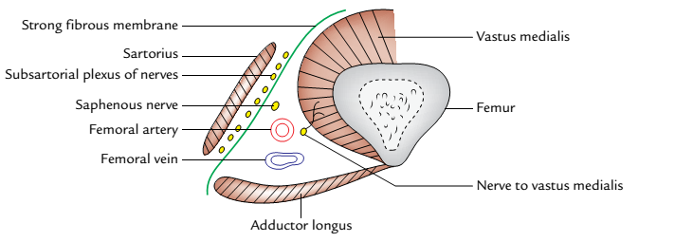
Boundaries and contents of the adductor canal as seen in the transverse section through middle one-third of the thigh.

Slide 14
Cont’d
The anterior division of obturator nerve passes downwards into the thigh in front of the obturator externus. It then descends behind the pectineus and the adductor longus, and in front of the adductor brevis.
The posterior division of obturator nerve runs on the anterior surface of the adductor magnus and ends by supplying the knee joint

Slide 15
APPLIED ANATOMY
The femoral artery is exposed and ligated in the adductor canal during surgery for aneurysm of the popliteal artery. This is because the artery at this side is healthy and does not tear when tied, which may occur if the artery is tied in the popliteal fossa immediately above the popliteal aneurysm.

Slide 16
THANK YOU ALL, FOR LISTENING.

Slide 17


